Slide 1

Visualization Dashboard
Cancer Deaths by Country by Year by Cancer Type
Brinton Cheng and Rich Goodier

Slide 2
Problem and Proposal
Cancer remains one of the leading causes of death worldwide, with significant variations in incidence and death across different regions and types. Understanding these variations is crucial.
Significant research in cancer incidents and deaths, comparing geographical regions, demographics, genetic communities.
Much of the statistical findings are geared towards field experts.
Need for Visualization Tools: Public, easy-to-use platforms for viewing and analyzing cancer data are essential for informed decision-making and improving outcomes.

Slide 3
Objective: to develop a data visualization dashboard that visualizes and predicts the trends and patterns in cancer deaths across different countries and cancer types from 1990 to 2016. The primary goal is to provide insights into cancer death trends, enabling healthcare stakeholders to better understand the dynamics of cancer outcomes over time and geographical spread.
The dataset is sourced from Kaggle, Cancer Deaths by Country and Type (1990-2016): https://www.kaggle.com/datasets/antimoni/cancer-deaths-by-country-and-type-1990-2016

Slide 4
Methodology
Import &
Preprocessing
EDA
Flask Skeleton
B&R
B&R
R
Filled in NaNs
Dropped unneeded columns
Parsed countries from regions
Eliminate redundancies
Integrated Data
Plot functions
R
B
Spreadsheet Page
Plot Page
Sorting
R
R
Filtering and Sorting
Filtering

Slide 5
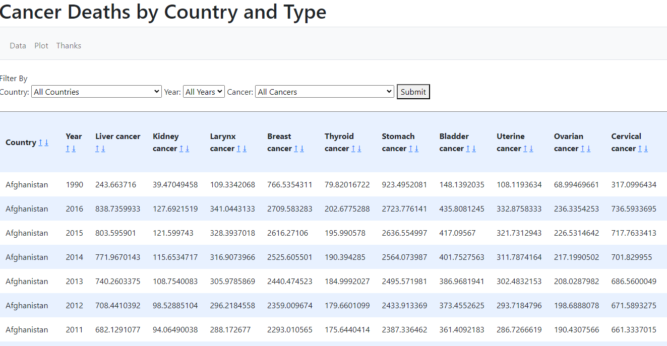
Spreadsheet Page

Slide 6
Architecture
index.html
plot.html
R
R
app.py
plot functions
initialization functions
R
R
B
import, clean,
initialize variables,
filter data
helper functions,
constants,
libraries
frontend
B&R
backend

Slide 7
Results
This dataset contains 27 type of cancers, across 27 year, and 184 countries, and 38 regions. It is ugly to show all of them in one plot.
So we reduce and combine the dataset down to top 5 cancers in term of mortality rate, and 5 continents in terms of regions and countries.
This is the structure of original dataset.
Country | Year | Liver cancer | Kidney cancer | … cancer
Afghanistan | 1990 | 243.6637 | 39.47049 | …
Afghanistan | … | … | … | …
Afghanistan | 2016 | 838.73599 | 127.6921519 | …
Western Europe
World

Slide 8
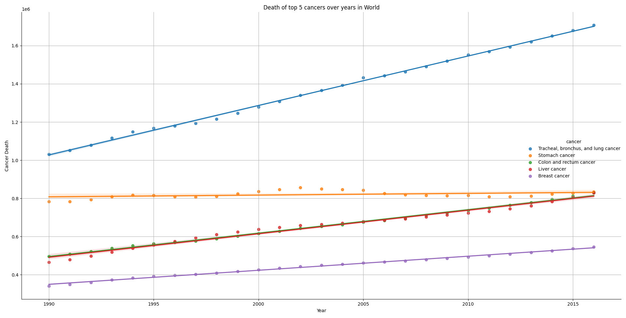
Results – world top 5 cancer mortality over years

Slide 9
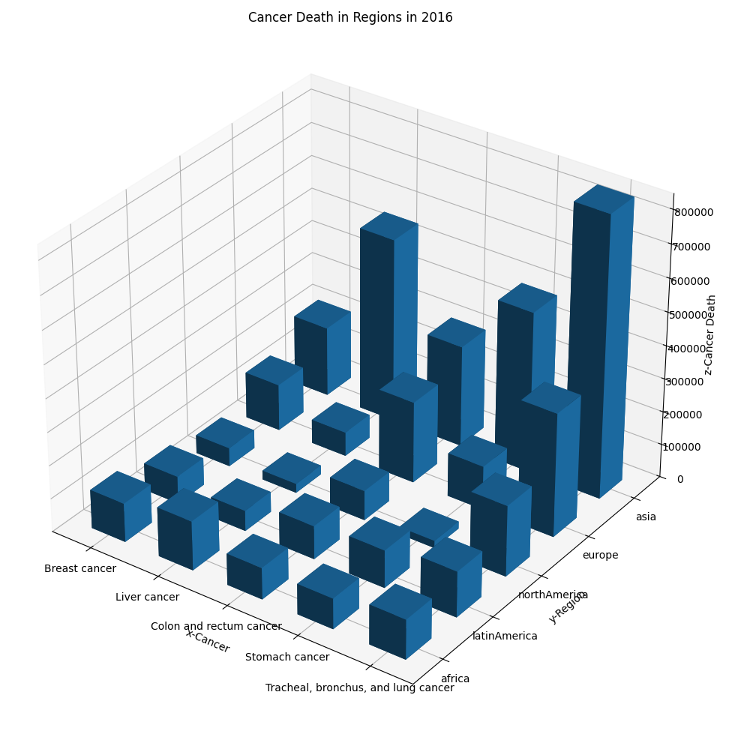
Results – cancers vs Continents in 2016
1. Lung cancer
2. Stomach cancer
3. Colon and rectum cancer
4. Liver cancer
5. Breast cancer

Slide 10
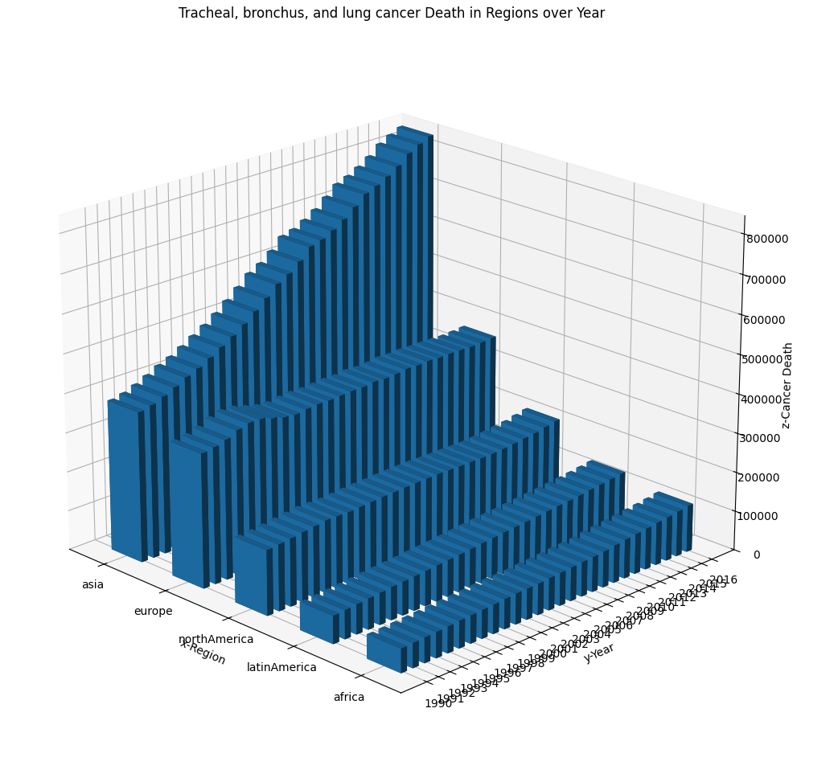
Discussion – lung cancer, continent vs year

Slide 11
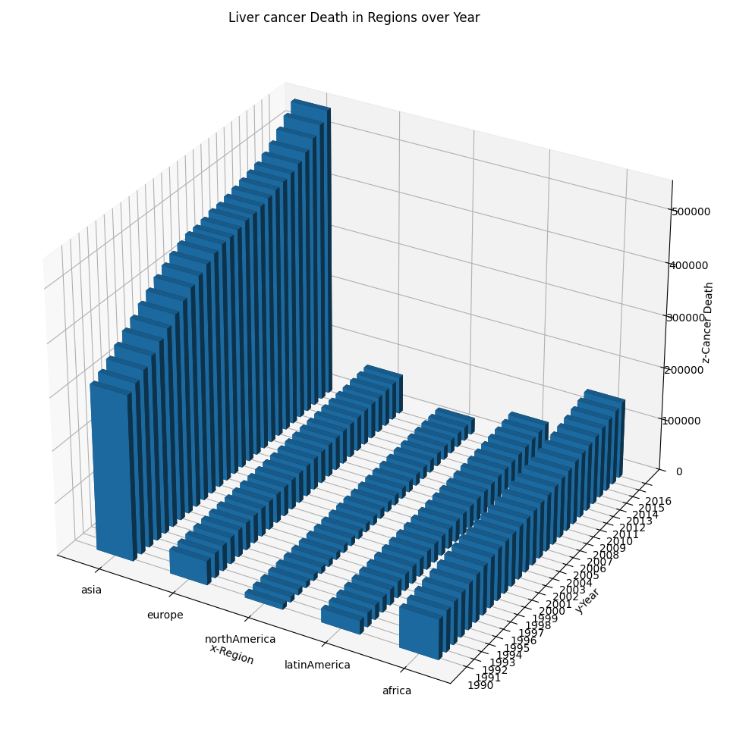
Discussion – liver cancer, continent vs year

Slide 12
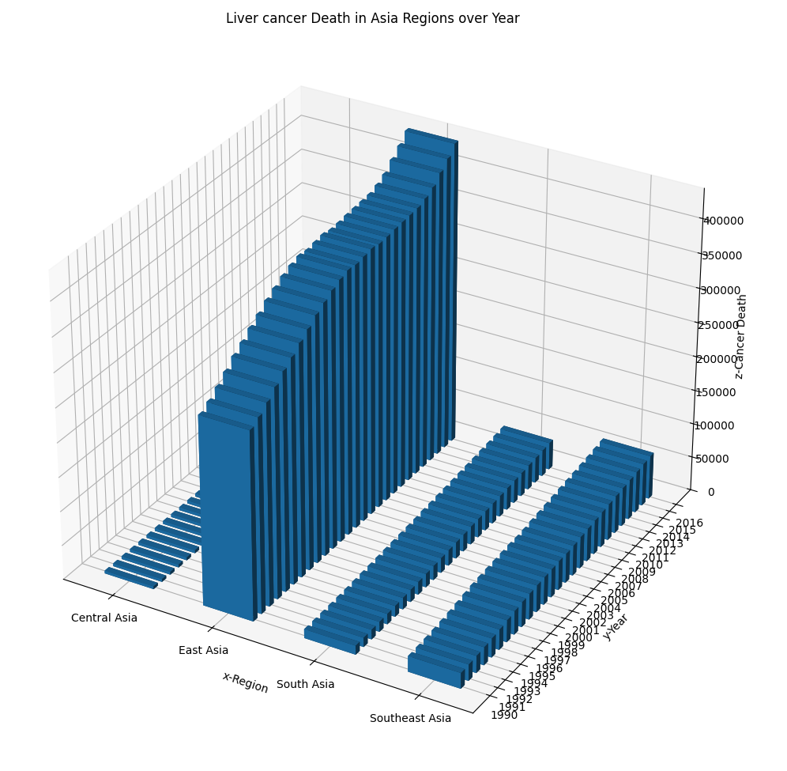
Discussion – liver cancer, Asia regions vs year

Slide 13
Methodology
Import &
Preprocessing
EDA
Flask Skeleton
B&R
B&R
R
Filled in NaNs
Dropped unneeded columns
Parsed countries from regions
Eliminate redundancies
Integrated Data
Plot functions
R
B
Spreadsheet Page
Plot Page
Sorting
R
R
Filtering and Sorting
Filtering

Slide 14
Future Work
Import &
Preprocessing
EDA
Flask Skeleton
parse countries and regions
Integrated Data
Plot functions
countries and regions dfs
Spreadsheet Page
Plot Page
move filtered data both ways
choose countries OR regions
more plot options
finished
future work
Predictive Models

Slide 15
Conclusion
Our Visualization Dashboard proved to be the most useful tool in answering statistical questions regarding the dataset.
Through its use, we discovered trends with ease and rapidity.
The overall number of cancer deaths has increased over the period studied.
There are regional disparities, such as N America and Europe’s high colon and rectum cancer numbers
Some cancers, like stomach cancer, have shown a marked decrease.
Incorporating more data (population numbers, lifestyle factors, etc.) and functionality (plot features) would facilitate further insights.

Slide 16
GitHub link:
https://github.com/Brintoncheng/DS-5110-Final-Project

